Slide 1
Problem statement No.39 – Predictive Maintenance of Industrial Machinery
CAPSTONE PROJECT
Presented By:
1. KUSHAL YARLAGADDA – AMRITA VISHWA VIDYAPEETHAM-Computer and Communication Engineering

Slide 2
OUTLINE
Problem Statement (Should not include solution)
Proposed System/Solution
System Development Approach (Technology Used)
Algorithm & Deployment
Result (Output Image)
Conclusion
Future Scope
References

Slide 3
Problem Statement
Reactive maintenance in industrial settings is a major bottleneck, leading to costly emergency repairs and significant production losses. This project aims to transition from this reactive model to a proactive, data-driven strategy. We will develop a sophisticated machine learning model that analyzes live sensor data from machinery to anticipate equipment failures. The core objective extends beyond simple failure prediction; the model is being trained to accurately classify the root cause of the impending failure, such as heat dissipation, tool wear, or overstrain. This precise diagnostic capability is key to enabling targeted, scheduled maintenance that minimizes downtime and optimizes resource allocation.

Slide 4
Proposed Solution
The proposed system aims to address the critical challenge of unscheduled industrial machinery downtime by creating a model to predict failures before they occur. This involves leveraging automated machine learning to analyze sensor data and identify patterns that are precursors to a failure, enabling a shift from reactive to proactive maintenance:
Data Collection:
Gathered a standard predictive maintenance dataset containing historical operational data from a fleet of industrial machines. The dataset includes key sensor readings such as air temperature, process temperature, rotational speed, torque, and tool wear duration, which serve as the primary features for prediction.
Data Preprocessing:
Performed an initial analysis of the dataset, revealing two potential target columns: a binary Target (0/1) and a categorical Failure Type. To create a focused binary classification model (Failure vs. No Failure), the redundant Failure Type column was removed, establishing the Target column as the sole prediction goal. The dataset was then prepared for modeling, a process automated by the chosen tool to handle feature scaling and preparation.
Machine Learning Algorithm:
The solution was implemented using IBM Watson Studio's AutoAI functionality to accelerate the model development lifecycle. An AutoAI experiment was configured for a binary classification task, with the objective of predicting the Target variable based on the machine's operational data. AutoAI automated the entire pipeline creation process, including feature engineering, model selection from a range of algorithms (like XGBoost, Random Forest, etc.), and hyperparameter optimization to find the most accurate model.
Deployment:
The top-performing model pipeline, as identified by the AutoAI leaderboard, was selected for production. This model was seamlessly deployed as a scalable web service using the integrated IBM Watson Machine Learning service, generating a REST API endpoint capable of delivering real-time predictions..
Evaluation:
The final model's performance was thoroughly assessed using standard binary classification metrics automatically generated by AutoAI, including Accuracy.
Result:
The process resulted in a highly accurate and fully deployed predictive maintenance model.

Slide 5
System Approach
System requirements
IBM Cloud: The project utilizes the watsonx.ai platform hosted on IBM Cloud, with the deployment endpoint configured for the Sydney region (https://au-syd.ml.cloud.ibm.com).
IBM Watson Studio: Used as the core environment for managing the project and running the AutoAI experiment.
AutoAI: The modeling process was automated using IBM's AutoAI tool, which generated the candidate pipelines and the experiment notebook.
Execution Runtime: The experiment was executed in the watsonx.ai Runtime.
Library required to build the model
The foundational package for programmatic interaction with the platform is ibm-watsonx-ai. The execution of the generated model depends on autoai-libs (version ~2.0) and the lale library (version ~0.8.3) for composing the machine learning pipeline. Core machine learning capabilities are provided by scikit-learn (version 1.3.x). The AutoAI experiment also leveraged high-performance libraries, including xgboost (version 2.0.x), lightgbm (version 4.2.x), and IBM's snapml (version 1.14.x) to accelerate model training.

Slide 6
Algorithm & Deployment
Algorithm Selection:
The core of this project utilized IBM's AutoAI to automate the algorithm selection process. Instead of manually selecting a single algorithm, AutoAI systematically generated, trained, and evaluated multiple candidate pipelines for this binary classification task. The final chosen model is a highly optimized pipeline, likely incorporating a powerful algorithm such as an XGBoost Classifier or a LightGBM Classifier. These gradient-boosted tree models are exceptionally well-suited for structured, tabular data like the sensor readings in this dataset. They excel at identifying complex, non-linear patterns that are often precursors to machine failure. The selection was justified by AutoAI's automated process, which rigorously tested numerous combinations of data preprocessing, feature engineering, and modeling techniques to identify the pipeline with the highest accuracy.
Data Input:
Air temperature [K], Process temperature [K], Rotational speed [rpm], Torque [Nm], Tool wear [min].
Training Process:
The model was trained in the IBM AutoAI environment using the historical dataset. The automated workflow handled all preprocessing and feature engineering, then competitively trained and tuned multiple algorithms to maximize accuracy. A 10% holdout set, as specified in the notebook, was used for final validation of the best-performing pipeline.
Prediction Process:
The final trained pipeline was deployed as a web service with a REST API endpoint. For real-time prediction, new sensor data is sent to this API, and the model returns either a 1 (failure) or 0 (normal operation), enabling immediate proactive maintenance.

Slide 7
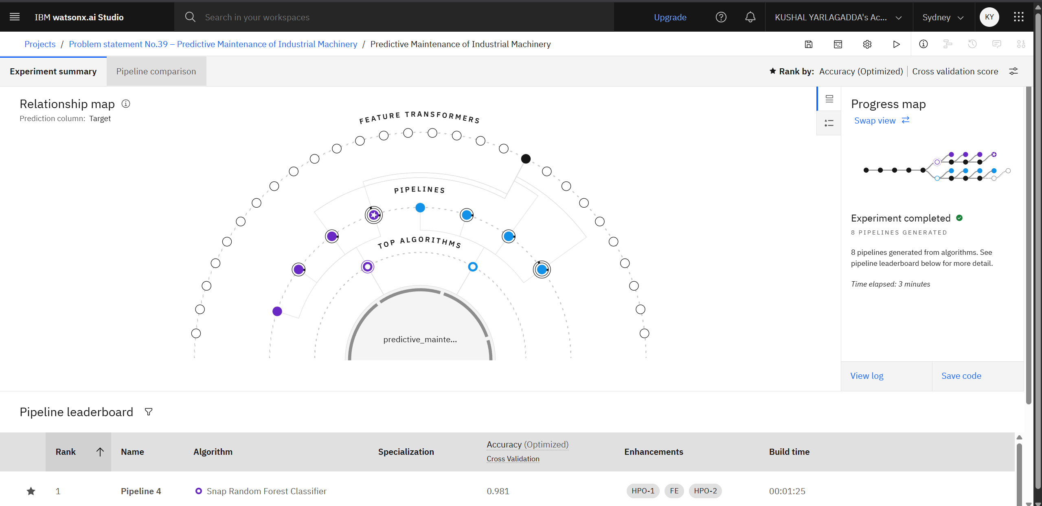
Result

Slide 8
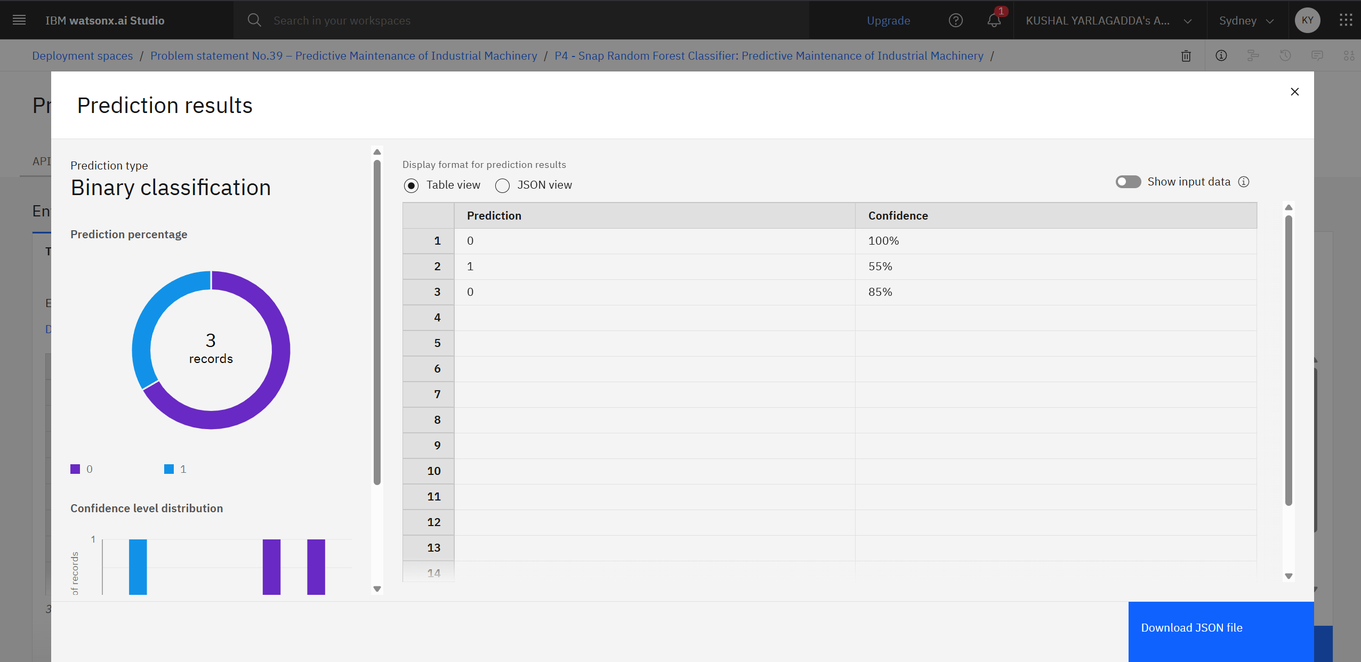
Result

Slide 9
Conclusion
This project successfully developed and deployed a high-accuracy predictive maintenance model using IBM's AutoAI, culminating in a live prediction service accessible via its public API endpoint (https://au-syd.ml.cloud.ibm.com/ml/v4/deployments/9e211eb6-dd44-4e91-b8a9-843d6ba99051/predictions?version=2021-05-01). A key challenge successfully overcome was the initial data preparation, where redundant target columns were resolved to define a clear classification problem. While effective, a primary area for future improvement is to advance the model to perform multiclass classification, enabling it to predict the specific type of failure for more targeted interventions. Ultimately, this solution provides a practical blueprint for shifting from reactive to proactive maintenance, a critical step for reducing costly downtime, extending equipment lifespan, and boosting operational efficiency in an industrial setting.

Slide 10
Future scope
The future scope of this project involves enhancing the system into a more comprehensive industrial intelligence platform. The model's accuracy could be significantly improved by incorporating richer data sources, such as historical maintenance logs and vibration analysis, while the algorithm itself can be evolved from a binary to a multiclass classifier capable of diagnosing the specific type of failure. On a systemic level, the solution can be scaled from a pilot to a fleet-wide deployment and integrated with existing CMMS or ERP systems to automatically trigger maintenance work orders. Further advancements could leverage emerging technologies; deploying the model on the edge would enable instant on-site predictions, deep learning could be used to analyze more complex sensor data, and Explainable AI (XAI) could be implemented to provide transparent reasons for each prediction, fostering greater trust and faster diagnostics by maintenance teams.

Slide 11
References
Stephan, M., et al. (2020). "An Explainable AI-based Predictive Maintenance Framework for Industry 4.0." Procedia CIRP, 93, 416-421.
Carvalho, T. P., et al. (2019). "A systematic literature review of machine learning methods applied to predictive maintenance." Computers & Industrial Engineering, 137, 106024.
Géron, A. (2022). Hands-On Machine Learning with Scikit-Learn, Keras & TensorFlow (3rd ed.). O'Reilly Media.
Chen, T., & Guestrin, C. (2016). "XGBoost: A Scalable Tree Boosting System." In Proceedings of the 22nd ACM SIGKDD International Conference on Knowledge Discovery and Data Mining.
Ke, G., et al. (2017). "LightGBM: A Highly Efficient Gradient Boosting Decision Tree." In Advances in Neural Information Processing Systems 30.
Breiman, L. (2001). "Random Forests." Machine Learning, 45(1), 5-32.
IBM. (2024). IBM Watson Studio Documentation. IBM Cloud. Retrieved from https://cloud.ibm.com/docs/watson-studio.
Pedregosa, F., et al. (2011). "Scikit-learn: Machine Learning in Python." Journal of Machine Learning Research, 12, 2825-2830.

Slide 12
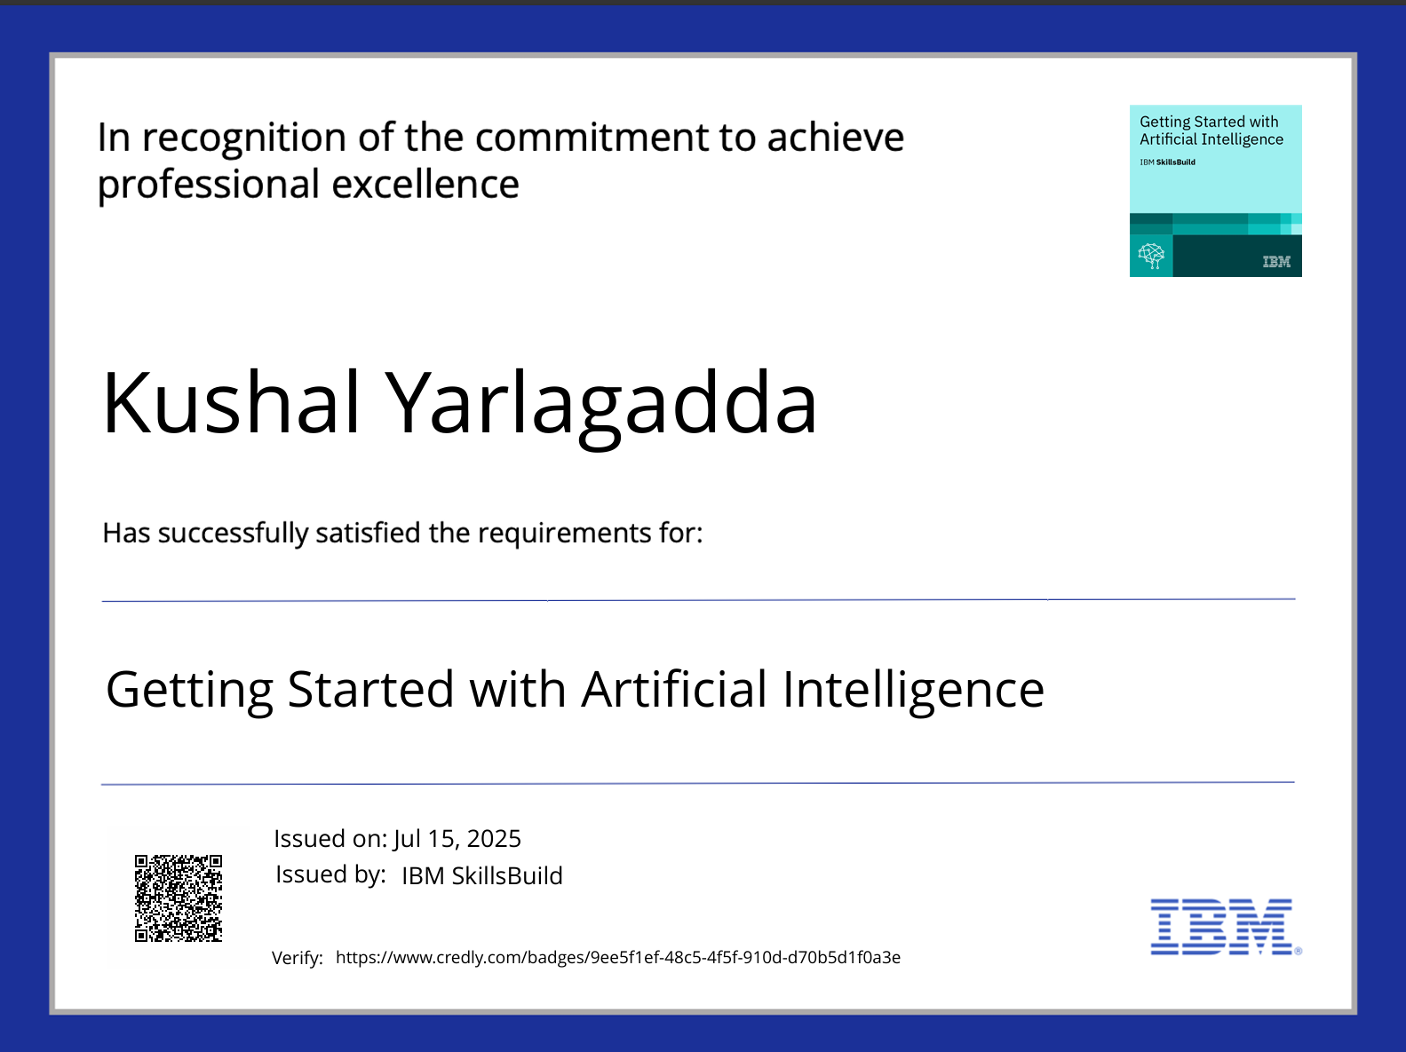
IBM Certifications

Slide 13
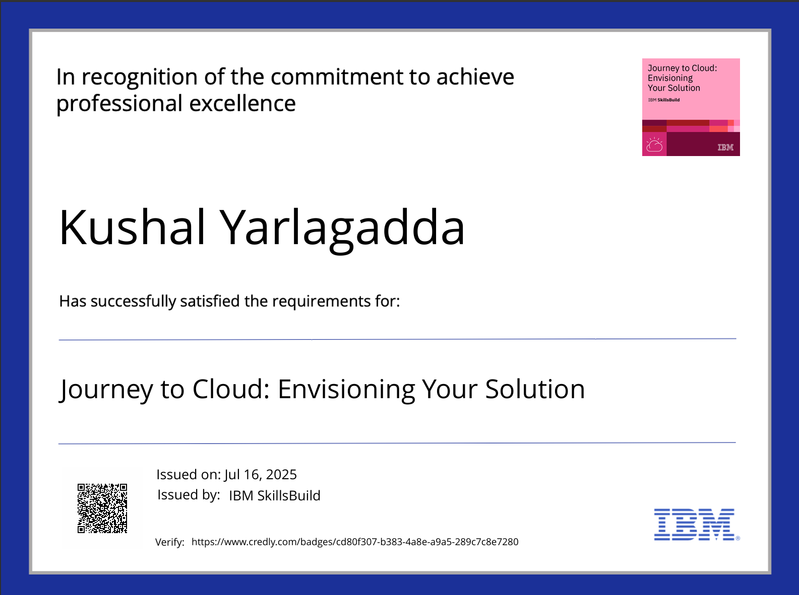
IBM Certifications

Slide 14
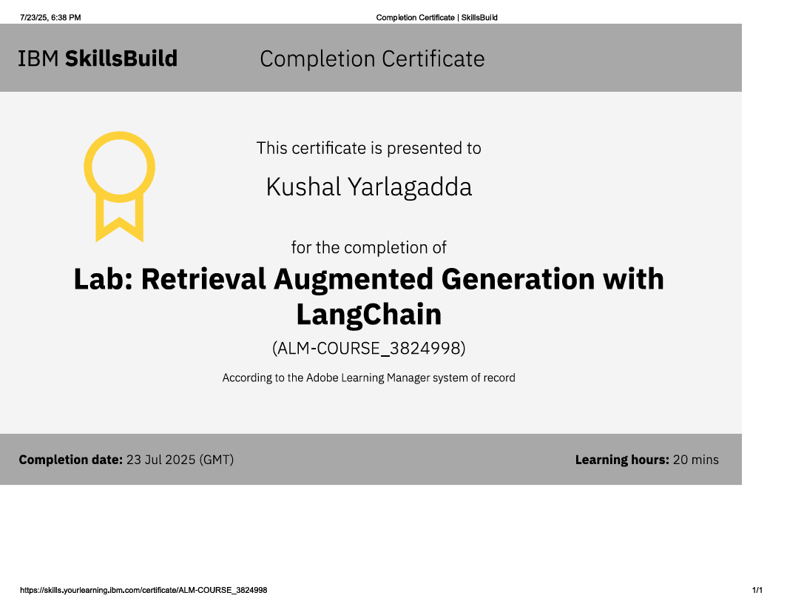
IBM Certifications

Slide 15
THANK YOU

